Slide 1
Task 3
Source Code Management and Build Automation

Slide 2
Branching strategies In Git
Gitflow Workflow
GitHub Flow
GitLab Flow

Slide 3
Key Terminologies
Git Branch: A parallel version of the code within a Git repository, allowing for separate development and experimentation.
Main Branch (formerly Master Branch): The primary branch of a Git repository where the production-ready code resides.
Feature Branch: A branch created to work on a specific feature or task isolated from the main branch.
Merge: The process of combining changes from one branch into another.
Pull Request (PR): A request made by a developer to merge their changes into another branch, often used for code review.
CI/CD Pipeline: Continuous Integration and Continuous Deployment pipeline, automating the process of building, testing, and deploying code changes.

Slide 4
What Is A Branching Strategy?
A branching strategy is a strategy that software development teams adopt for writing, merging and deploying code with the help of a version control system like Git.
It lays down a set of rules that aid the developers on how to go about the development process and interact with a shared codebase.
Strategies like these are essential as they help in keeping project repositories organized, error free and avoid the dreaded merge conflicts when multiple developers simultaneously push and pull code from the same repository.

Slide 5
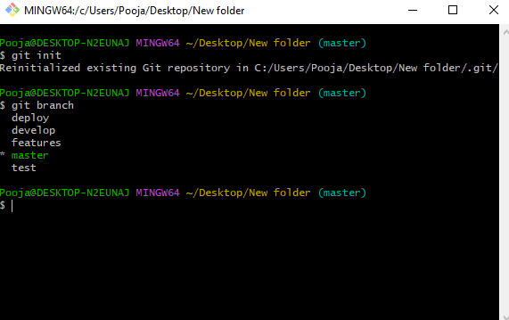
Git branch: In Git, a branch is a new/separate version of the main repository.

Slide 6
Jenkins cicd pipeline
CI/CD is a method to frequently deliver apps to customers by introducing automation into the stages of app development. The main concepts attributed to CI/CD are continuous integration, continuous delivery, and continuous deployment.

Slide 7
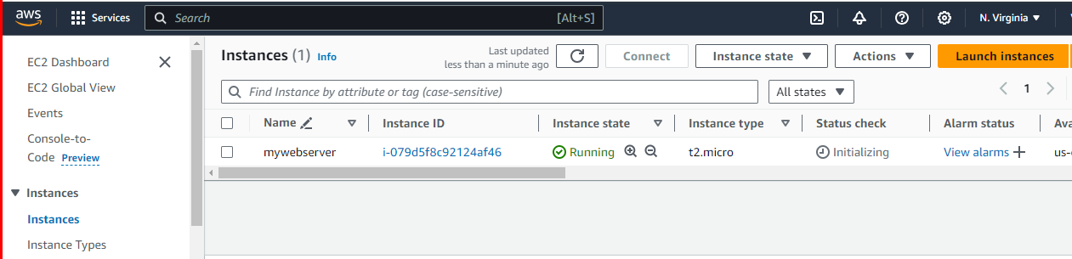
Create instance using Ec2 by using t2.micro

Slide 8
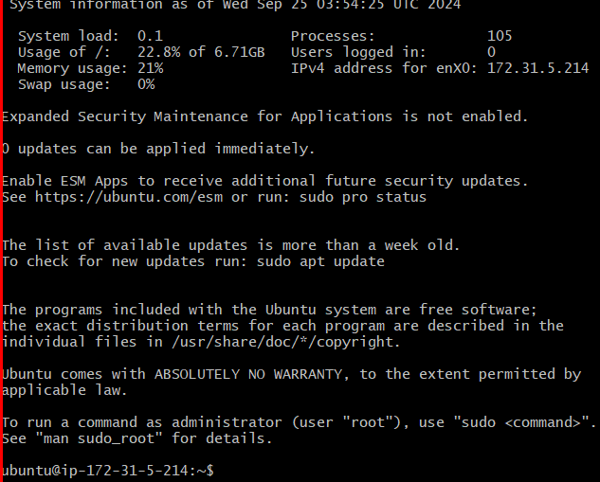
Connect instance to gitbash

Slide 9
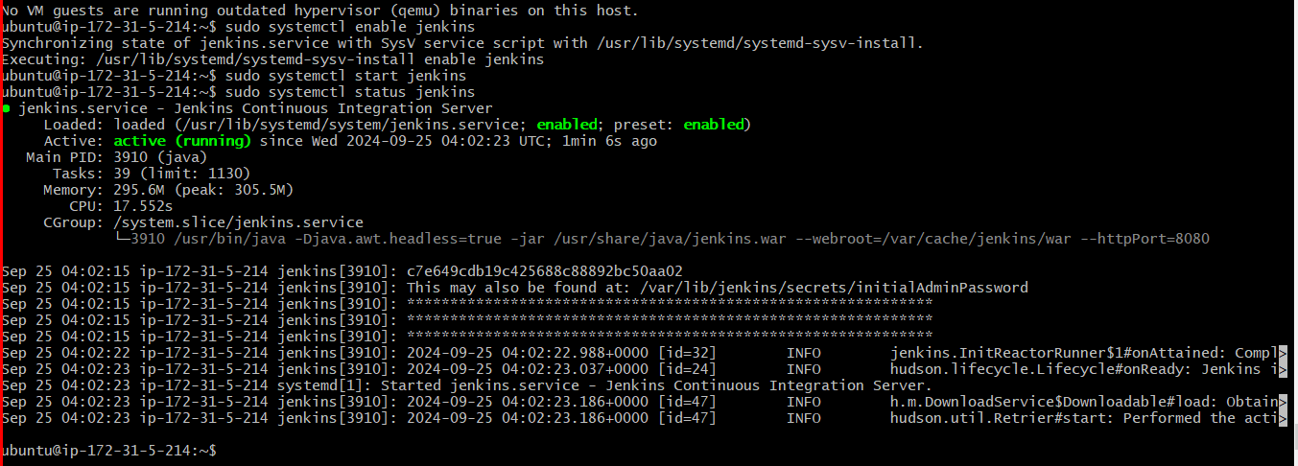
Install jenkins on server using ubuntu server and linux codes

Slide 10
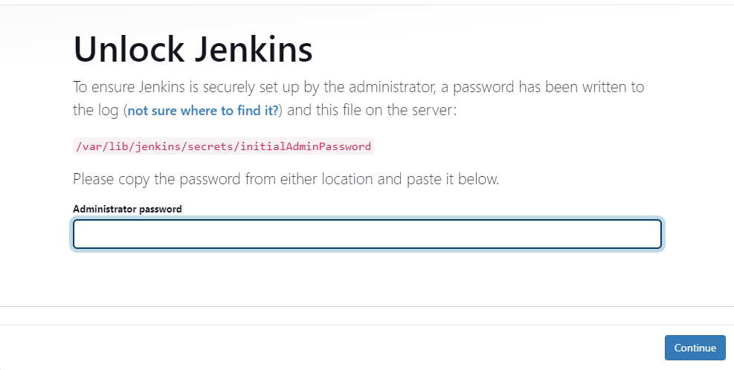
By using public ip address launch jenkins on web browser and use a port number as 8080

Slide 11
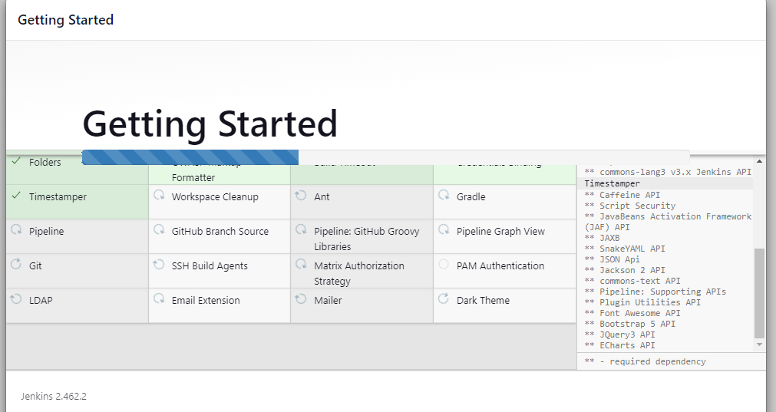
Setup jenkins follow as show below

Slide 12
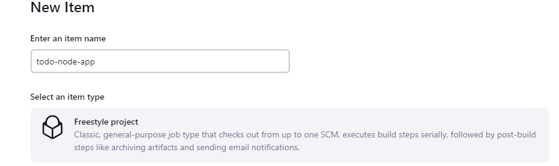
Select new item and create a new project on jenkins

Slide 13
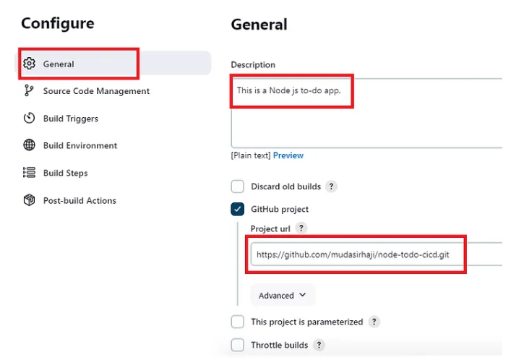
Connect git hub server to jenkins using github project url

Slide 14
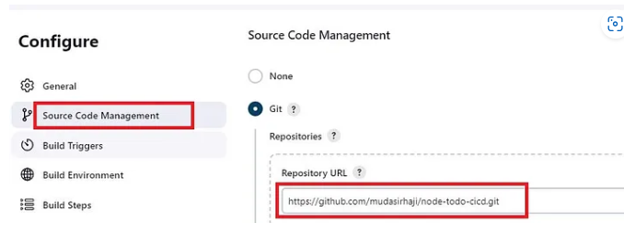
Adding Git Repository Url

Slide 15
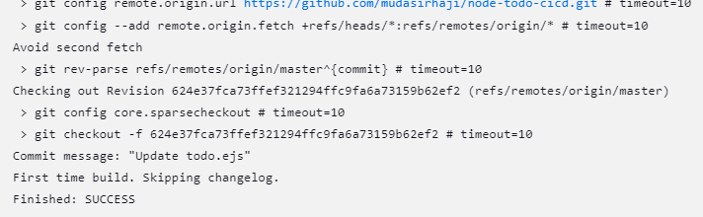
Run the pipeline code by using built now button and code get successed

Slide 16


